Slide 1

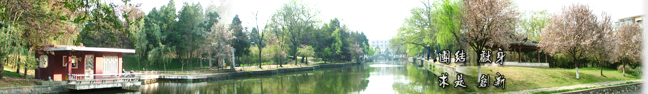
6 Temporal Alignment
EOE Postgraduate Courses
Multi-sensor Data Fusion
wangjingqi@njust.edu.cn

Slide 2
Contents
6.1 Introduction
6.2 Dynamic Time Warping
6.3 Dynamic Programming
6.4 Video Compression

Slide 3
6.1 Introduction
Definition
Temporal alignment （时间对准）is defined as the transformation T(t) which maps local sensor observation times t to a common time axis t’.
Often plays a critical role in applications operating in real-time.
Example 6.1. Cardiac （心脏的）MR Image Sequences.
Early diagnosis and treatment of Cardiovascular diseases is crucial in order to reduce mortality and to improve patient’s quality of life.
Cardiac registration ⎯⎯ to bring K sequences of cardiac images acquired from the same subject, or from the same subject at different times, into the same spatial-temporal coordinate system.
Temporal registration is performed to correct for any temporal misalignment caused by different acquisition parameters, different lengths of cardiac cycles and different motion patterns of the heart.

Slide 4
Assumption: Temporal alignment independent of position u
Let O = <E, u, t, y, Δy > denote a given sensor observation.
Strictly speaking T(t) is a function of the position u and the time t.
Commonly assuming it independent of u.
Example 6.2. Visualization of Dysphagia（吞咽障碍的可视化） (Disorders Associated with Swallowing).
For a given swallow S, a MRI camera provides a high resolution video sequence I_{i}, i ∈ {1, 2, . . ., N}, taken at times t_{i}, where t_{i} < t_{i} ₊₁.
For each sequence, we segment the bolus（造影用的丸剂） and track its path in the space-time volume of the swallow, by extracting the centroid, (ˉx, ˉy), of the segmented region from each MRI image and creating a path of the centroid motion.

Slide 5
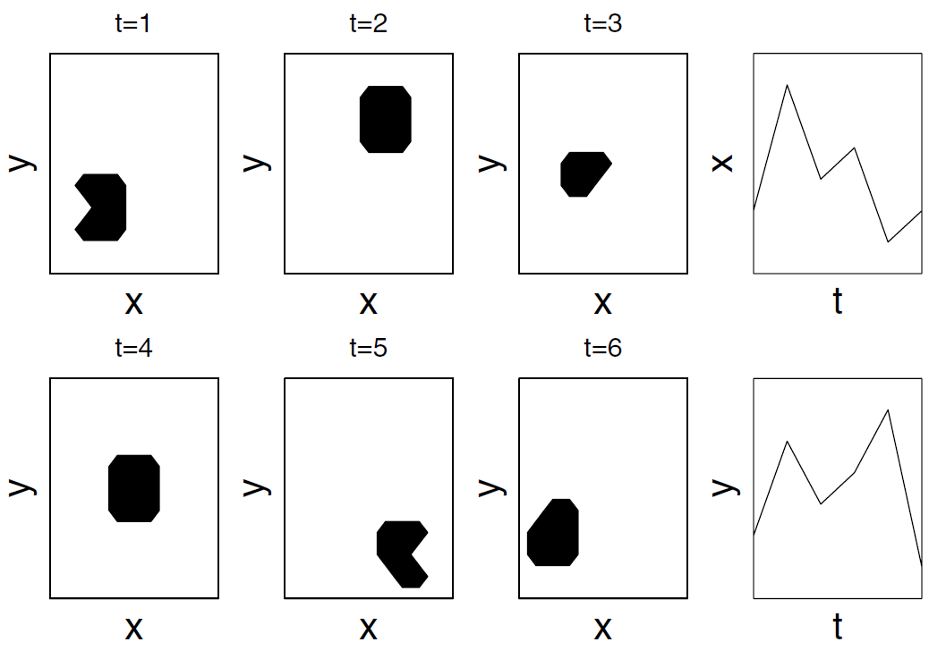
Creating a path of the centroid motion for each swallow.
x and y position of centroid of the bolus as a function of the time t.
Fig. 6.1. Six two-dimensional images I_{i}, i ∈ {1, 2, . . . , 6}, taken at times t = {1, 2, . . . , 6}.
The temporal registration ⎯⎯ matching the spatial-temporal paths of the bolus in multiple swallows to form a high resolution video.
Notes:
In each image we segment the bolus (which is shown as a dark irregularly shaped area).
The right images I_{i} show

Slide 6
Descriptions of the temporal alignment
We limit ourselves to temporal alignment of a time series, P, to a common time-axis t’. P = (P₁, P₂, . . . , P_{M})^{T} consists of M sensor observations, P_{i} = <E_{i}, ∗, t_{i}, y_{i}, ∗>, i ∈{1, 2, . . .,M}, made with the same sensor and ordered in time, i.e. t_{i} < t_{i} ₊₁.
We do not have an independent time-axis t’. Instead, we shall define the time-axis t’ by a second time series Q, where Q consists of N sensor observations, Q_{j} = <E_{j}, ∗, t’_{j}, y’_{j}, ∗>, j ∈ {1, 2, . . .,N}.

Slide 7

6.2 Dynamic Time Warping （动态时间弯折）
Definition
DTW finds the optimal alignment between two time series P and Q in the sense that it minimizes the sum of the local distances d(i, j) between the aligned observation pairs (P_{i},Q_{j}).
E.g. we define d(i, j) as the square of the Euclidean distance:
DTW warps the time axes, t and t’, in such a way that corresponding sensor observations appear at the same location on a common time axis. ⎯⎯ aligned in a non-linear way.

Slide 8
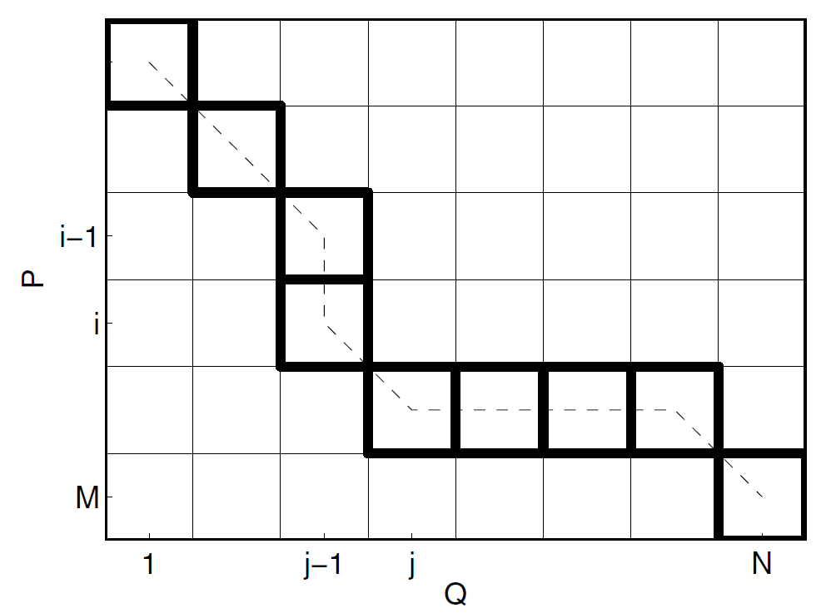
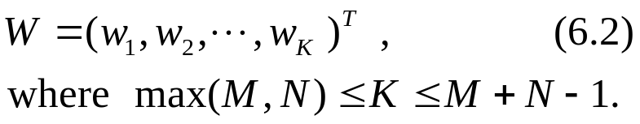
“warping path” W （弯折路径）
For a given alignment of P and Q, W is a set of matrix elements w_{k} = (i_{k}, j_{k}), k ∈ {1, 2, . . .,K}, w_{k} ⎯ a mapping between the observations P_{ik} and Q_{jk} .
Top-to-bottom
Left-to-right
w₁=(1,1), D(1,1)=d(1,1)
D(i,j) ⎯ the cumulative distances of the neighboring cells.
D(M,N) ⎯ the optimal matching cost.
Optimal warping path W_{DTW}, dashed line & thick-bordered cells.
Fig. 6.2. Dynamic Time Warping (DTW) algorithm.
W_{DTW}, provides information about the optimal correspondence (alignment) between the two time series P and Q.

Slide 9
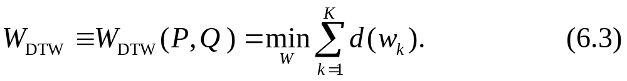
Constraints on warping paths
Boundary Conditions. w₁ = (1, 1) and w_{K} = (M,N). ⎯ Warping paths start by matching the first observation of P with the first observation of Q and end by matching the last observation of P with the last observation of Q.
Continuity. ⎯ Given w_{k} = (a, b), then w_{k −1} = (a’, b’), where a − a’ ≤ 1 and b−b’ ≤ 1. This restricts the allowable steps in the warping path.
Monotonicity. ⎯ a − a’ ≥ 0 and b−b’ ≥ 0. This forces the warping path sequence to increase monotonically in time.
Optimal warping paths ⎯⎯ the path which minimizes the sum of the local distances d(i_{k}, j_{k}) ≡ d(w_{k}).
The optimal warping path W_{DTW} can be recovered by tracing back the sequence of optimal neighbors.

Slide 10
6.3 Dynamic Programming （动态规划）
Computation complexity
A brute force method → an exponential number of warping paths.
Construction of the cumulative cost matrix D(m, n)
finding the optimal warping path, W_{DTW}, with cost, DTW(P,Q), in O(MN) time, using recursion:
Where, D(i_{k}, j_{k}) ⎯ the cost of the optimal warping path from (1,1) to (i_{k}, j_{k}); D(1,1)=d(1,1).

Slide 11
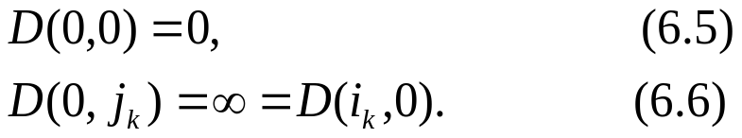
Procedure of DTW algorithm
building a M × N table D(m, n),m ∈{1, 2, . . .,M}, n ∈ {1, 2, . . .,N}, column by column.
starting with n = 1 and computing D(1, 1) using (6.4) and the boundary conditions
from m = 2 to m = M, computing D(2,1), D(3,1), …, D(M,1).
increasing n by one, from m = 1 to m = M computing D(1,2), D(2,2), …, D(M,2).
continuing the process until the last column n = N and row m = M are reached.
D(M,N) is the minimum cost equal to DTW(P,Q). The optimal warping path, W_{DTW}, is obtained by tracing the recursion backwards from D(M,N).

Slide 12
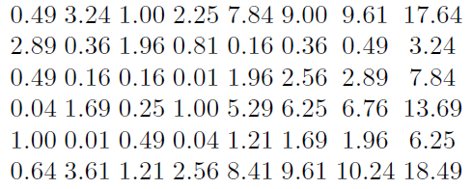
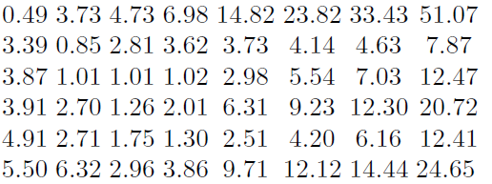
Example 6.3. Dynamic Programing.
Given two time series P = (1.7, 4.1, 3.1, 2.2, 3.4, 1.6)^{T}
and Q = (2.4, 3.5, 2.7, 3.2, 4.5, 4.7, 4.8, 5.9)^{T},
a matrix of squared Euclidean distances d(i, j) = (P_{i} − Q_{j})² :
The corresponding cumulative matrix D is:
DTW(P,Q) = 24.65

Slide 13
Fig. 6.2. Dynamic Time Warping (DTW) algorithm.
the optimal warp path:
W_{DTW} = ((1, 1), (2, 2), (3, 3), (4, 3), (5, 4), (5, 5), (5, 6), (5, 7), (6, 8))^{T} .
Notes:
By tracing back , we find the corresponding optimal warp path.

Slide 14

Application examples
Example 6.4. Speech-Recognition in an Embedded-Speech Recognition System.
A DTW speech-recognition system works as follows.
ω^{(l)} and Q^{(l)}, l∈{1, 2, . . ., L} ⎯ a set of L reference words and their corresponding time series.
An unknown input time series P.
DTW algorithm tis used to optimally match P to each Q^{(l)}, l∈ {1, 2, …, L}, in turn.
If DTW(P,Q(l)) denotes the cost of matching P with Q^{(l)}, then we assign P to the word Ω = ω_{OPT}, where

Slide 15
Example 6.5. Word-Spotting in Historical Manuscripts.
Physical basis: for collections of handwritten manuscripts written by a single author, the images of multiple instances of the same word are likely to look similar.
Word spotting algorithm ⎯ Each page is segmented into words; An image matching algorithm is used to cluster different instances of a given word. An index is created by annotating the clusters which links words to the locations where they occur.
Matching process ⎯ dividing each word image into columns of equal width Δ；extracting four features, (a_{i}, b_{i}, c_{i}, d_{i})^{T}; converting each word image into a multivariate series of feature values in which the horizontal image axis functions as a time axis. → matching any two word images P and Q by matching their multivariate feature values using the DTW algorithm.

Slide 16
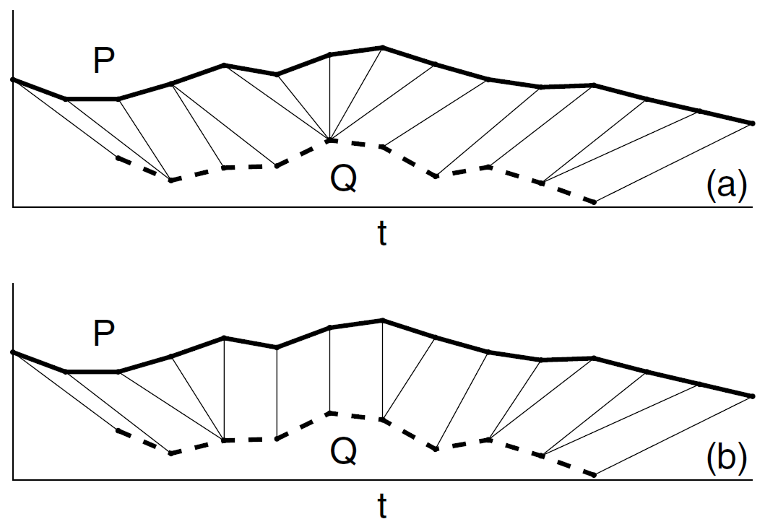
6.3.1 Derivative Dynamic Time Warping
DTW try to explain a difference between P and Q by unnaturally warping the two time axes t and t’.→ can produce pathological results.
a single point map onto a large subsection of another time series
Fig. 6.3. (a) Matching using the traditional DTW algorithm with an Euclidean local cost function. (b) Matching of the same curves using a DDTW algorithm.
To deal with these singularities, an additional constraint is to place on W.

Slide 17
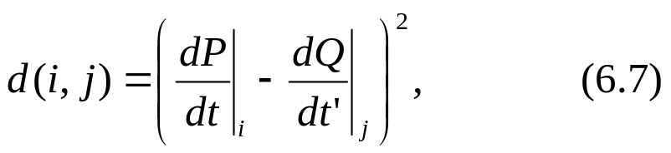
Constraints on W
Windowing. ⎯ constrain W so it does not deviate too far from the diagonal path (as defined by the end points w₁ and w_{K}). The distance that the path is allowed to deviate is the window length R.
Slope Constraint. ⎯ constrain W so it is not too steep and not too shallow.
where α is positive real number.
A different local cost function
Derivative dynamic time warping (DDTW) algorithm ⎯ using a local distance d(i, j), which is defined as the square of the difference between the slopes of the curves P and Q at the times ti and t’j .

Slide 18
Example 6.6. Identifying a Face Profile Using the DDTW Algorithm.
Most current face profile recognition algorithms rely on the detection of fiducial points.
Features such as a convex nose, protruding lips or a flat chin make the detection of such points difficult and unreliable.
The number and position of the fiducial points vary when the expression changes even for the same person.
The DDTW algorithm is used to match an unknown face profile P to a data base of known face profiles Q(l), l ∈ {1, 2, . . ., L}.

Slide 19
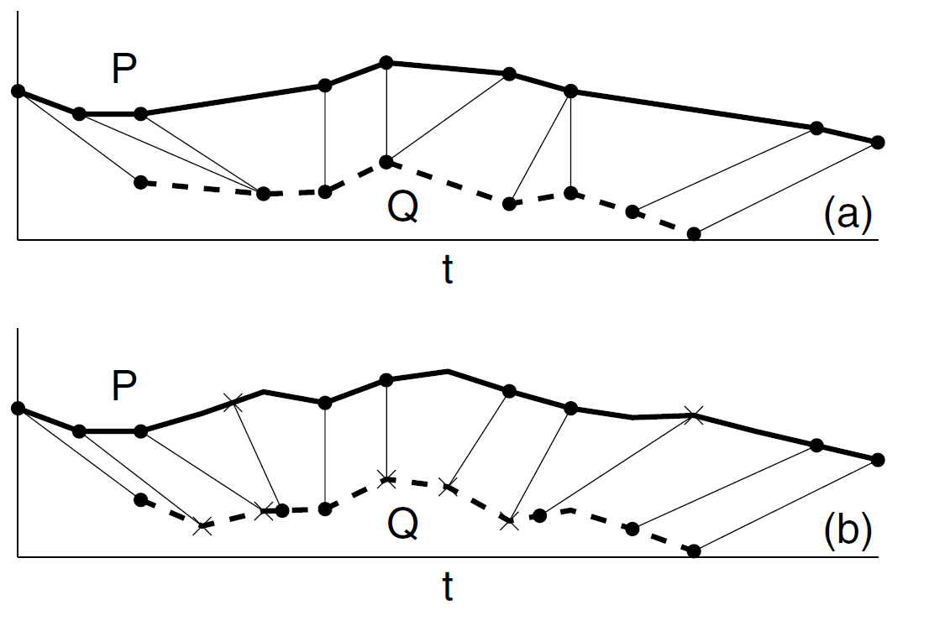
6.3.2 Continuous Dynamic Time Warping
An observation P_{i} is allowed to match a point which lies between Q_{j} and Q_{j−1} , and Q_{j} is allowed to match a point which lies between P_{i} and P_{i−1}.
A particular interpolation model is required to generate the intermediate matching points.
Example 6.7. Signature Verification Using Continuous Dynamic Time Warping.
× — Interpolated points
Fig. 6.4. (a) Matching of two curves P = (P₁, P₂, . . . , P₄)^{T} and Q = (Q₁,Q₂, . . . ,Q₅)^{T} using the traditional DTW algorithm. (b) Matching of the same curves using a continuous DTW algorithm.
Notes:
连续的动态时间弯折

Slide 20


6.4 Video Compression （视频压缩）
Original time series P which consists of a sequence of M images P_{i}, i∈ {1, 2, . . .,M}, taken at times t_{i}. → Compressed by forming a new time series Q which consists of N images Q_{j}, j∈{1, 2, . . .,N}, at times t’_{j} . Q_{j} are created by selectively
1. “Dropping” the input images P_{i}.
2. “Repeating” the input images P_{i}.
3. Interpolating consecutive input images P_{i−1} and P_{i}.
A model
where, α_{j} ∈ [0, 1] is a given interpolation weight.
rewrite (6.8) using a warping path V = (v₁, v₂, . . . , v_{N})^{T}, where v_{j} = i denotes a mapping between the compressed image Q_{j} and a pair of original images P_{vj} and P_{vj−1}:

Slide 21
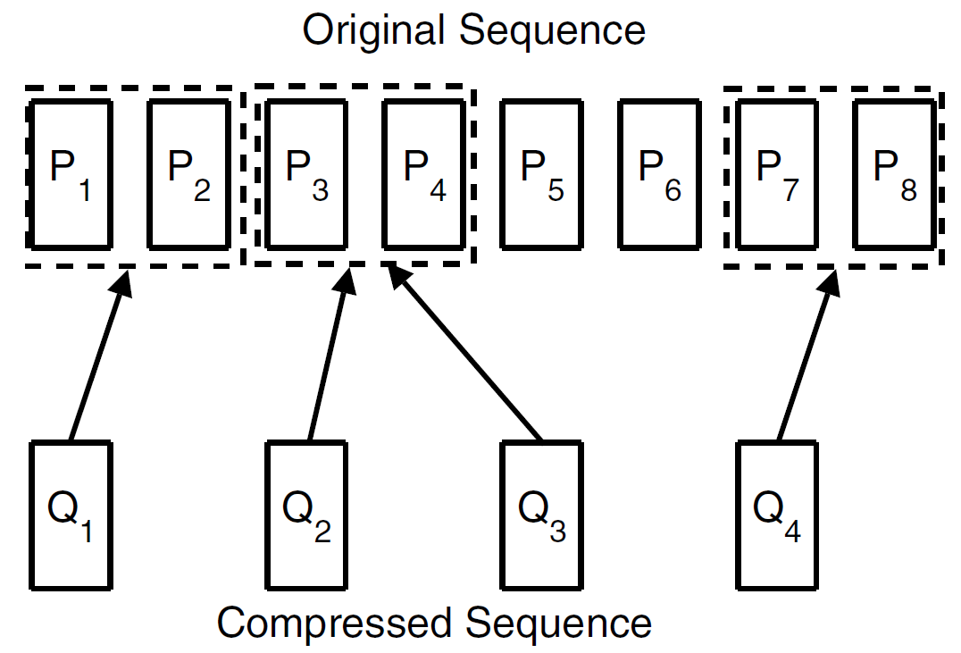
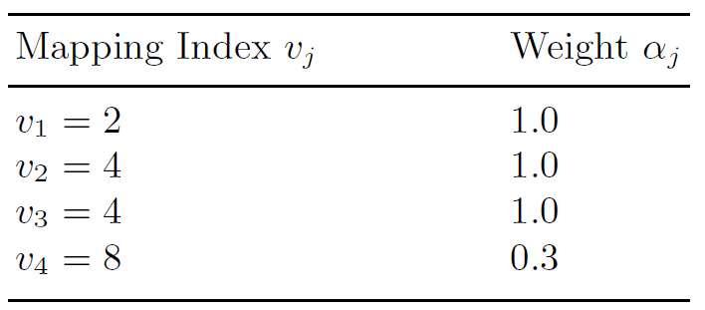

Example 6.8. Compressed Video Sequence.
Table 6.1. Mapping indices v_{j} and weights α_{k}
Fig. 6.5. The use of the temporal model to represent a compressed video sequence.
Q₁ and Q₂ correspond, respectively, to the original images P₂ and P₄;
Q₃ is a “repeat” of Q₂ (i. e. Q₃ = Q₂);
Q₄ is a weighted average of the images P₇ and P₈;
Ignore, or “drop”, the images P₁, P₃, P₅ and P₆ .

Slide 22
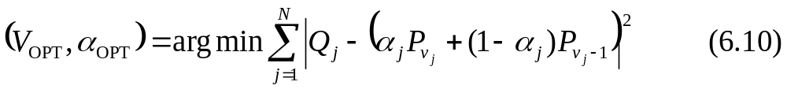
Constraints on warping paths V
Boundary Conditions. v₁ = 2 and v_{N} = M. ⎯ the warping path starts by matching Q₁, with P₁ and P₂ and to end by matching Q_{N}, with P_{M−1} and P_{M}.
Monoticity. Given v_{j} = a, then v_{j−1} = a’, where a−a’ ≥ 0. ⎯ the warping path increases monotonically in time.
Note: Continuity constraint is not used because of frame “dropping”.
Optimal warping paths V_{OPT}
the optimal warping path, V_{OPT}, and the optimal interpolation weights, α_{OPT}, are jointly defined as
V_{OPT} minimizes the sum of the square errors between Q and P. It is a monotonically non-decreasing path in a two-dimensional, (i, j), space.

Slide 23
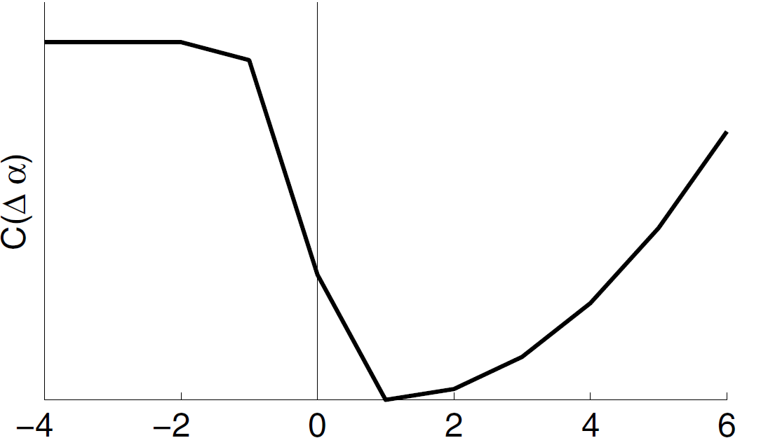
Additional constraints reflecting a priori information
In video compression, frame repeat is used infrequently and is seldom repeated more than once. This information included as an additional constraint C.
Example 6.9. Frame Repeat Constraint C.
Causal constraint ⎯ setting C(Δv) to the maximal distortion when Δv < 0, i. e. when v_{j} < v_{j−1}.
Smooth transition among static scenes ⎯ setting C(Δv) = 0 when Δv = 1, i. e. when v_{j}= v_{j−1}+1.
Penalizes frame repeat ⎯ setting C(Δv) equal to a positive cost when Δv = 0, i. e. when v_{j} = v_{j−1}.
Δv = v_{j}− v_{j -1}
Fig. 6.7. Contextual cost function C(Δv), where Δv = v_{j}− v_{j -1}.
Enforcing causal constraint and encouraging smooth transition when frames have little motion or are static and penalizing the decision of frame repeat.

Slide 24
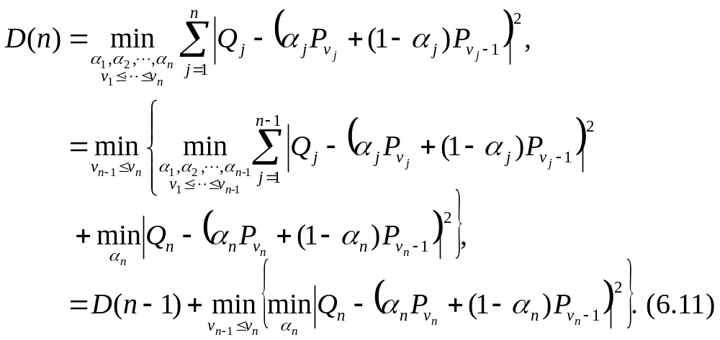
Finding V_{OPT} using dynamic programming
Let D(n) denote the accumulated square error over an initial segment of V_{OPT} from j = 1 to j = n, then
A monotonically non-decreasing path V_{OPT} has the minimal sum of square errors.

Slide 25
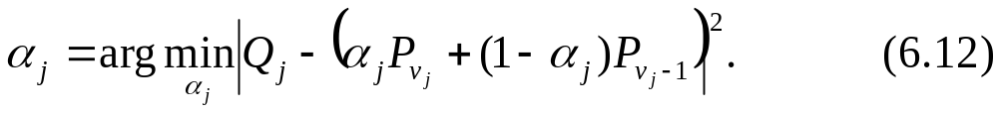
Optimized process of V_{OPT}
1. Find the optimum weight, α_{j} , for each compressed image Q_{j}, j∈{1, 2, … ,N}:
2. Recursively compute D(j), j∈ {1, 2, …,N}, using the optimum weight α_{j} , in (6.11).
3. After completing the calculation of D(N), trace back to find the optimum warping path, V_{OPT}, and the optimum weight vector, α_{OPT}.

Slide 26

Thank you for your attention!

